Slide 2
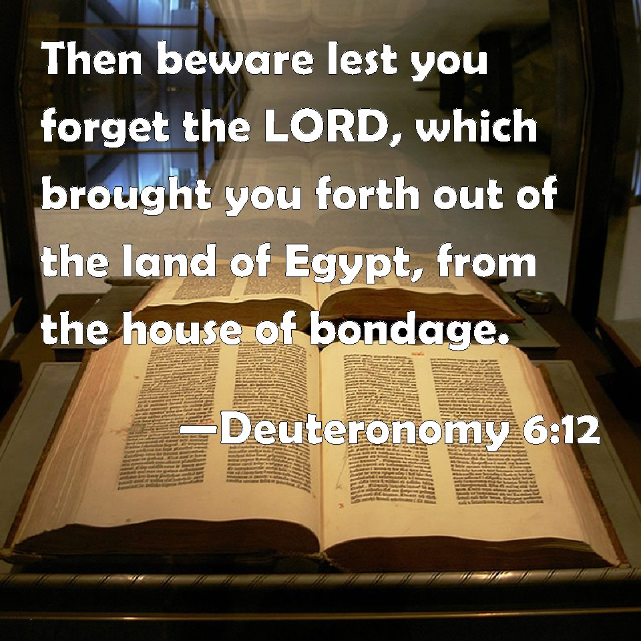

Slide 3
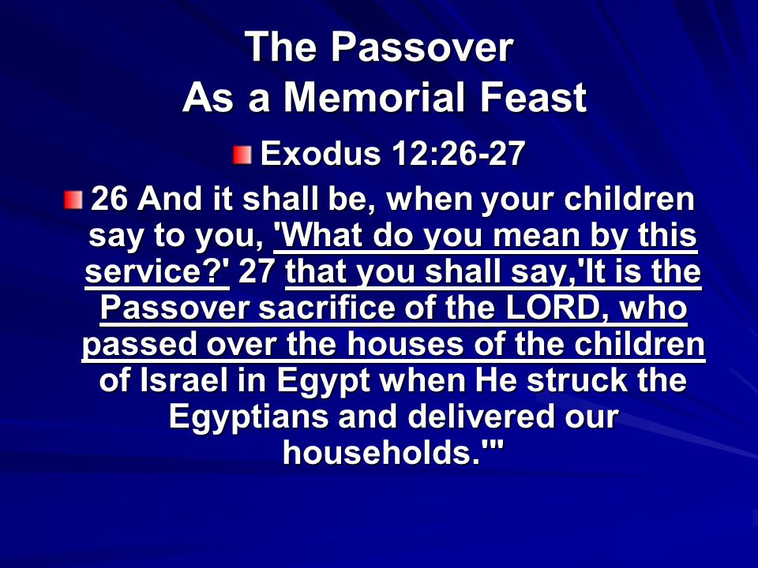

Slide 4
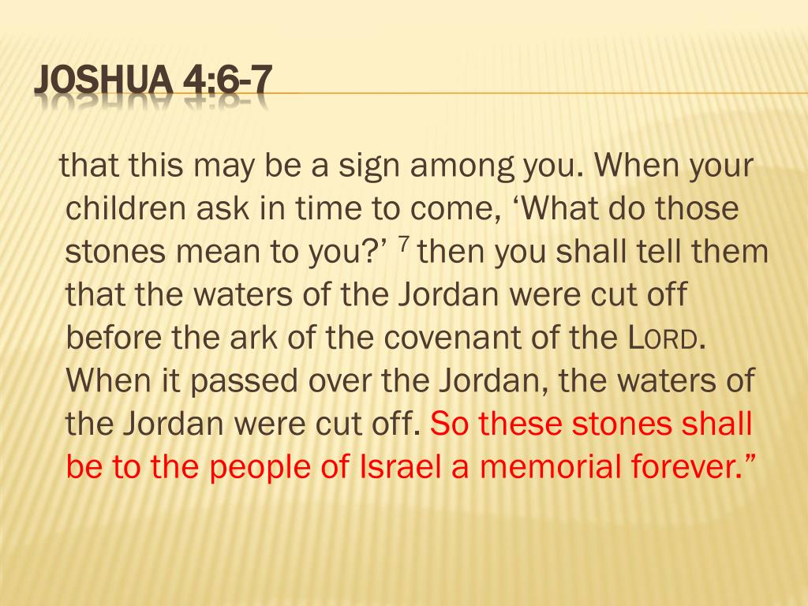


Slide 5
Israel Forgot God!
Jeremiah 18:12-17 NKJV 12 And they said, "That is hopeless! So we will walk according to our own plans, and we will every one obey the dictates of his evil heart." 13 Therefore thus says the LORD: "Ask now among the Gentiles, Who has heard such things? The virgin of Israel has done a very horrible thing. 14 Will a man leave the snow water of Lebanon, Which comes from the rock of the field? Will the cold flowing waters be forsaken for strange waters? 15 "Because My people have forgotten Me, They have burned incense to worthless idols. And they have caused themselves to stumble in their ways, From the ancient paths, To walk in pathways and not on a highway, 16 To make their land desolate and a perpetual hissing; Everyone who passes by it will be astonished And shake his head. 17 I will scatter them as with an east wind before the enemy; I will show them the back and not the face In the day of their calamity."

Slide 6
2 Peter 1:12 “For this reason I will not be negligent to remind you always of these things, though you know and are established in the present truth.”
Forgetfulness A Common Tendency Of Man
Life Of A Christian Centers Around Jesus Christ
1 Corinthians 15:6 “After that He was seen by over five hundred brethren at once, of whom the greater part remain to the present, but some have fallen asleep.”

Slide 7
What Are We To Remember About Christ?
Remember Who He Is:
Supreme Being – John 1:1-3,14 “In the beginning was the Word, and the Word was with God, and the Word was God… Word became flesh and dwelt among us”
Philippians 2:6 “being in the form of God”
Matthew 16:18 “on this rock I will build My church”
1 Timothy 3:16 “God was manifested in the flesh”
Philippians 2:9,10; Revelation 4:11

Slide 8
What Are We To Remember About Christ?
Remember The Life He Lived:
Compassion, Pity for Lost Humanity – John 10:10; Acts 10:38
Revelation of God in Flesh – Colossians 2:9
1 Peter 2:21 “leaving us an example”
Hebrews 12:2 “Jesus, the author and finisher of our faith”
  Sinless Life – 1 Peter 2:22,23 “Who committed no sin” 2 Corinthians 5:21 “Him who knew no sin” Hebrews 10:5-10

Slide 9
What Are We To Remember About Christ?
Remember His Teaching:
He Taught With Authority – Matthew 7:29
His Teaching Was Not His Own- John 17:8
Remember His Death – Isaiah 53:4,5
Philippians 2:8 “obedient to the point of death, even the death of the cross.” WHY DID HE DIE? Provide for ATONEMENT – Psalm 85:10 “Mercy and truth have met together” Hebrews 12:2
Remember Resurrection & Accession – Hebrews 2:14,15; Matthew 16:18; Acts 2:31-33

Slide 10
What Are We To Remember About Christ?
Remember His Present Work:
God’s Spokesman- Hebrews 1:2; 12:25
He is King of Kings – Philippians 2:9,10; 1 Timothy 6:15
Merciful High Priest – Hebrews 7:24,25
Remember Our Relationship To Him:
1 Corinthians 6:19,20 “you were bought at a price” Committed to Him as LORD!
United To Him – 2 Corinthians 11:2 “I have betrothed you to one husband, that I may present you as a chaste virgin to Christ.” Galatians 5:24

Slide 11
How Are We To Remember Christ?
In Worship:
Lord’s Supper – 1 Corinthians 11:24,25
Singing – Colossians 3:16
Teaching – Acts 2:42; 20:32
Prayer – Ephesians 5:20
Giving – 2 Corinthians 9:6,7
In Every Activity:
Colossians 3:17 “do all in the name of the Lord Jesus, giving thanks to God the Father through Him.”

Slide 12
CHRIST ASK THAT MAN “REMEMBER HIM”
HE SHOULD BE REMEMBERED!
IT IS A GREAT INJUSTICE TO FORGET!
WHY NOT REMEMBER THE GREATEST BENEFACTOR AN HAS EVER KNOWN?
REMEMBER: CHRIST DIED FOR YOU!
THIS WAS DONE TO MAKE IT POSSIBLE FOR YOU TO BE RICH, TO ESCAPE ETERNAL CONDEMNATION YOU RIGHTFULLY DESERVE!

